Slide 1
Battle Tetris
2011 Fall CS202 Problem Solving
Final Project

Slide 2
What to do…
Project name: Battle Tetris
Motivated by HanGame Tetris
http://tetris.hangame.com
You should make AI algorithm for Tetris
Input
You and other person’s current state of board (board, targetBoard)
Kind of current and next block(piece) (nextBlock)
And other context information (nowCombo, holdBlockNum, isOnHold, numOfGarbageLines, holePositionX)
Output
Where and how to drop the block (posX, turn)
Whether you will store(or exchange) the block or not (useHold)
Message to show

Slide 3
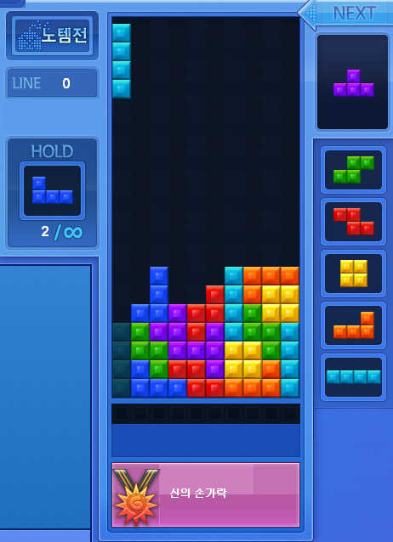
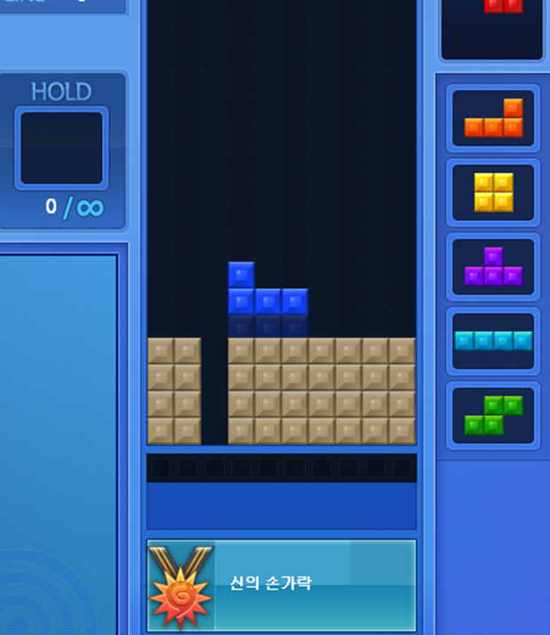
Tetris
If you delete(clear) 4 lines at once(tetris), the other party will be given 4 garbage lines
If you delete 3 lines at once -> 2 garbage lines
If you delete 2 lines at once -> 1 garbage line

Slide 4
Back-to-Back Tetris
A back-to-back tetris is, as the name states, a tetris (clearing 4 lines at a time) that's been cleared in a chain of consecutive tetrises.
the other party will be given 5 garbage lines
Back-to-Back
Tetris!
Drop tetris(I) block with clearing 4 lines
Drop non-tetris blocks without clearing
Drop non-tetris blocks without clearing
Drop tetris(I) block with clearing 4 lines
…
*http://answers.yahoo.com/question/index?qid=20080622152014AABZA48

Slide 5
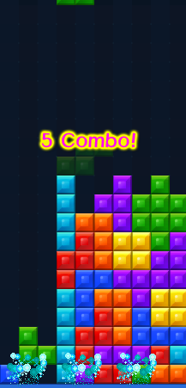
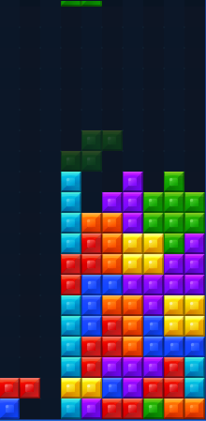
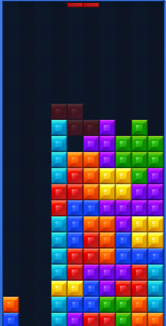
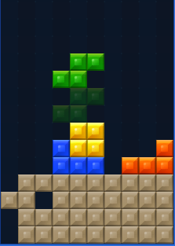
Combo System
After consecutive line deletion, the other party will be given..
3~4 Combo : 1 line
5~6 Combo : 2 lines
7~8 Combo : 3 lines
9~11 Combo : 4 lines
3 COMBO
4 COMBO
5 COMBO
Enemy’s board
My board

Slide 6
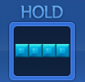
Holding Block
You can store or exchange a block
If repository is empty
Current block is stored
Else
Current block is exchanged for the block in repository
You can’t use ‘hold’ consecutively without dropping the block

Slide 7
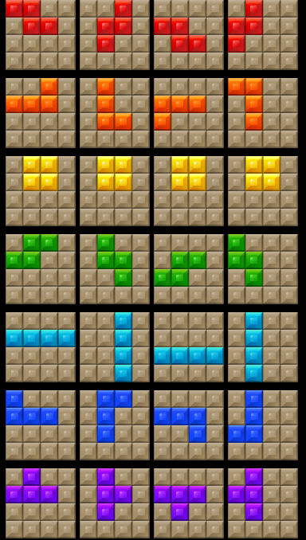
Block Information
# of turn(rotation)
0
1
2
3
Block No.1
0
1
2
3
Block No.2
0
Block No.3
1
Block No.4
2
Block No.5
3
Block No.6
Block No.7

Slide 8
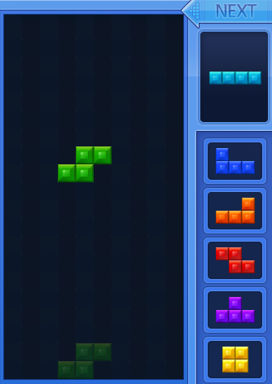
7-piece Bag System
Block count
Block Kind No.
1 | 2 | 3 | 4 | 5 | 6 | 7 | 8 | 9 | 10 | 11 | 12 | 13 | 14 | 15 | 16 | 17
1 | 5 | 4 | 3 | 6 | 2 | 7 | 7 | 5 | 4 | 1 | 2 | 3 | 6 | 1 | 6 | 4
Random order
Random order
Game server generates next blocks that will be used in game
Block no. will not be overlapped in 1-7, 8-14, 15-21…
Each block will be shown within 13 consecutive drops

Slide 9
Game & Decision Information
Game Information(you will be given) board; //My game board targetBoard; //Enemy’s game board nextBlock[7]; //Block info.(index 0 is current block) nowCombo; // # of current combo holdBlockNum; // # of current hold block(empty==0) isOnHold; // Whether ‘hold’ is used in previous decision. //You can use ‘useHold’ on decision if this value is false(0) numOfGarbageLines; // # of garbage lines to be pushed holePositionX[5]; // The x-position of the hole in garbage lines
Decision Information(you should send) posX; // X position of dropping block(Pivot Position)
turn; // # of rotation
useHold; // If useHold value is true(1), use ‘hold’
message; //Message to show (do not exceed 128 character)

Slide 10
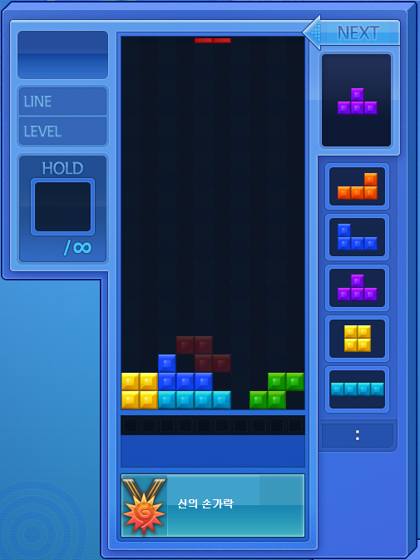
Board Presentation
0 1 2 3 4 5 6 7 8 9
0
1
2
3
4
5
6
7
8
9
10
11
12
13
14
15
16
17
18
19
20
21
0 | 0 | 0 | 0 | 0 | 0 | 0 | 0 | 0 | 0
0 | 0 | 0 | 0 | 0 | 0 | 0 | 0 | 0 | 0
0 | 0 | 0 | 0 | 0 | 0 | 0 | 0 | 0 | 0
0 | 0 | 0 | 0 | 0 | 0 | 0 | 0 | 0 | 0
0 | 0 | 0 | 0 | 0 | 0 | 0 | 0 | 0 | 0
0 | 0 | 0 | 0 | 0 | 0 | 0 | 0 | 0 | 0
0 | 0 | 0 | 0 | 0 | 0 | 0 | 0 | 0 | 0
0 | 0 | 0 | 0 | 0 | 0 | 0 | 0 | 0 | 0
0 | 0 | 0 | 0 | 0 | 0 | 0 | 0 | 0 | 0
0 | 0 | 0 | 0 | 0 | 0 | 0 | 0 | 0 | 0
0 | 0 | 0 | 0 | 0 | 0 | 0 | 0 | 0 | 0
0 | 0 | 0 | 0 | 0 | 0 | 0 | 0 | 0 | 0
0 | 0 | 0 | 0 | 0 | 0 | 0 | 0 | 0 | 0
0 | 0 | 0 | 0 | 0 | 0 | 0 | 0 | 0 | 0
0 | 0 | 0 | 0 | 0 | 0 | 0 | 0 | 0 | 0
0 | 0 | 0 | 0 | 0 | 0 | 0 | 0 | 0 | 0
0 | 0 | 0 | 0 | 0 | 0 | 0 | 0 | 0 | 0
0 | 0 | 0 | 0 | 0 | 0 | 0 | 0 | 0 | 0
0 | 0 | 0 | 0 | 0 | 0 | 0 | 0 | 0 | 0
0 | 0 | 6 | 0 | 0 | 0 | 0 | 0 | 0 | 0
3 | 3 | 6 | 6 | 6 | 0 | 0 | 0 | 4 | 4
3 | 3 | 5 | 5 | 5 | 5 | 0 | 4 | 4 | 0
Will not be shown

Slide 11
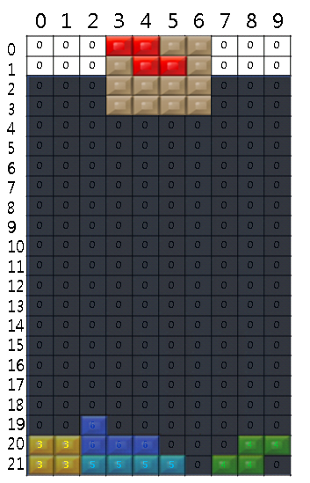
Board Presentation
Pivot
Current Block No : 1
Pos X : 3
Pos Y : 0 Turn : 0
Example)
board[20][0]= 3
board[20][8]= 4
nextBlock[]={1,7,2,6,7,3,5}
*X position of pivot can be minus value(e.g -2 )

Slide 12
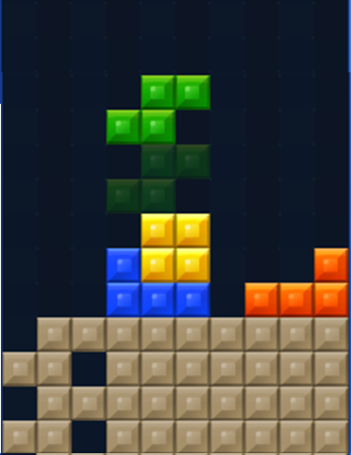
Garbage Block Info.
Garbage line information that will be received after your decision is in ‘numOfGarbageLines’ and ‘holePositionX’
Example)
For 3 COMBO
numOfGarbageLines:1 holePositionX[4]={0,0,0,0,0}
For 4 COMBO
numOfGarbageLines:1 holePositionX[4]={2,0,0,0,0}
For 5 COMBO
numOfGarbageLines:1 holePositionX[4]={0, 2,0,0,0}
3 COMBO
4 COMBO
5 COMBO

Slide 13
Win & Lose Condition
You will win
The other party is died
You will lose
If the block that you chose is crashed the current blocks in your board or walls
Consecutive use of ‘hold’
Draw condition
If two players are died together within 0.5 seconds

Slide 14
Additional Information
Server will react your decision after ‘Respond Time Limit’’ seconds from the time that the server sent the game info.
Example) If Respond Time Limit is 0.5
0.5 seconds
Time
0.2
0.4
0.7
Server
Auto Moving
Request(game info.)
Request(game info.)
Respond(decision info.)
Client

Slide 15
Additional Information
For AI vs AI or AI vs nobody
Garbage blocks will be pushed after some time to prevent tedious play
Seconds | 60 | 70 | 80 | 90 | 95 | 100 | 105 | 110 | 115 | 120 | 125 | 130 | 135 | 140 | 142 | 145 | 147 | 150 | 153 | 155
Lines | 1 | 1 | 1 | 2 | 2 | 2 | 2 | 2 | 2 | 2 | 2 | 3 | 3 | 3 | 3 | 3 | 3 | 4 | 4 | 4

Slide 16
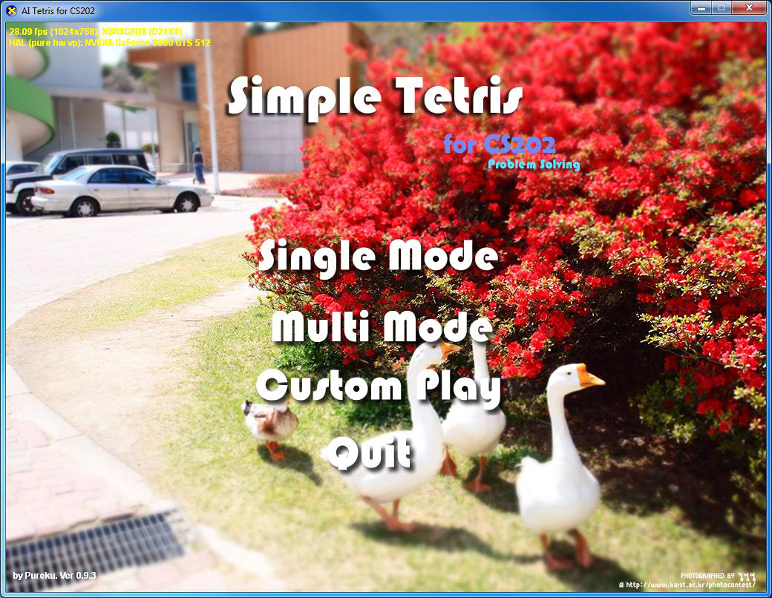
Game Images
Title Screen

Slide 17
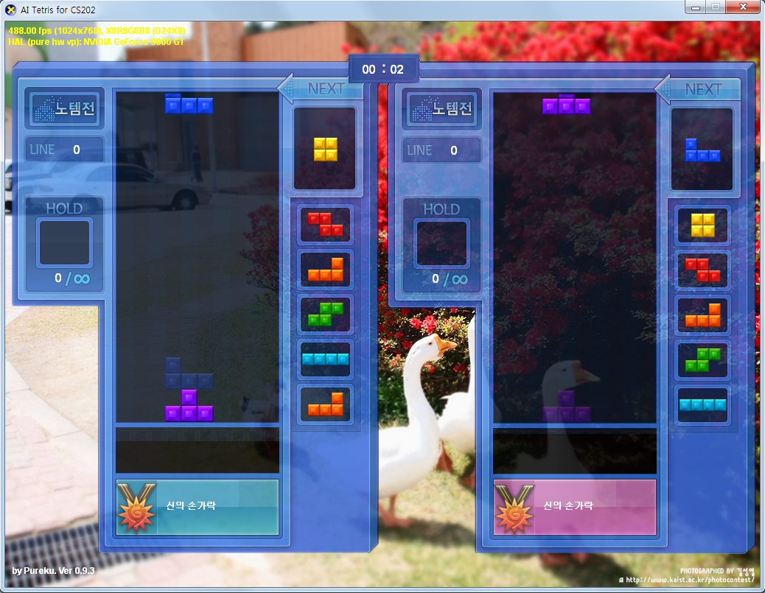
Control keys
You can control block by keyboard in ‘Single Mode’ or ‘Multi Mode’
Single Mode or ‘Person vs AI’
Move & Rotate: Arrow keys
Hard drop: Space key
Hold: Shift key
Multi Mode
1P
Move& Rotate: ‘R’,’D’,’F’,’G’
Hard drop: Left shift key
Hold: ‘Z’
2P
Move& Rotate: Arrow keys
Hard drop: Right shift key
Hold: ‘/’

Slide 18
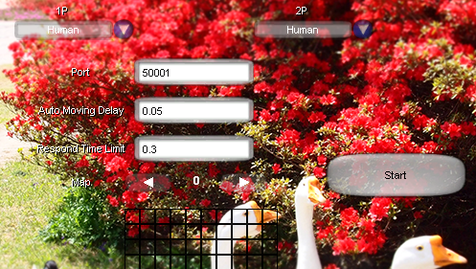
Custom Play
You can connect AI client after setting and clicking ‘start’ button

Slide 19
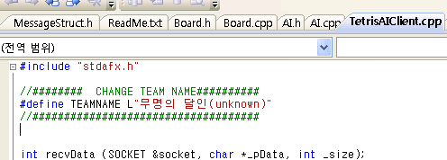
AI Client
C++ Client
Implemented by using visual studio 2010
Set team name in ‘TetrisAIClient.cpp’ file
Implement ‘AI::decision(Game_Info gameInfo)’ method
Java Client
Implemented by using eclipse(you can import project file)
Set team name by changing field named ‘TEAM_NAME’ in AI.java
Implement ‘AI.decision(GameInfo gameInfo)’ method
Sample heuristic algorithm is implemented in ‘decision’ method to show how to implement AI

Slide 20
AI Tetris Protocol Specification
2011 Fall CS202 Problem Solving
Final Project

Slide 21
Protocol Overview
Client
Server
connect
accept
1) Send Team Name
2) Request Solution
3) Send Decision
2) Request Solution
3) Send Decision
. . .
disconnect

Slide 22
1) Send Team Name
Team Name [256 bytes]
Should be encoded with UTF-16 Little-endian
End with NULL(0) character

Slide 23
2) Request Solution
Game information [456 Bytes]
{ BYTE board[22][10]; //My game board(BYTE is unsigned char in c) BYTE targetBoard[22][10]; //Enemy’s game board BYTE nextBlock[7]; //Block info.(index 0 is current block) BYTE nowCombo; // # of current combo BYTE holdBlockNum; // # of current hold block(empty==0) BYTE isOnHold; // You can’t use ‘hold’ if true BYTE numOfGarbageLines; // # of garbage lines to be pushed BYTE holePositionX[5]; // The x-position of the hole in garbage lines
}

Slide 24
3)Give Decision
Decision information [264 Bytes] { int posX; // X position of dropping block BYTE turn; // # of rotation BYTE useHold; // Use ‘hold’ if useHold is not 0 BYTE message[256] //Message to show
BYTE reserved[2]; //For aligning struct(don’t use) }
int is little-endian byte order
Message should be encoded with UTF-16 Little-endian

